Slide 1
Bilateral Z transform Relationship to DTFT

Slide 2
Z-Transform
z-transform: polynomial representation of a sequence
Bilateral vs. Unilateral
Two sided or bilateral z-transform
Unilateral z-transform

Slide 3
Relationship to the Discrete Time Fourier Transform (DTFT)
If we replace the complex variable z in the z-transform by e^{jw}, then the z-transform reduces to the Discrete Time Fourier transform (DTFT).
The DTFT is simply the z-transform when evaluating X(z) only on a unit circle in the z-plane.
From another point of view, we can express the complex variable z in the polar form as z = re^{jw}. With z expressed in this form,
Thus the z-transform can be interpreted as the DTFT of the product of the original sequence x[n] and the exponential sequence r^{−n}.
For r=1, the z-transform reduces to the Fourier transform.

Slide 4
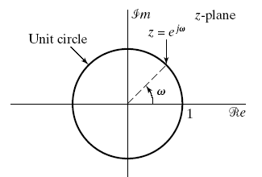
Relationship to the Discrete Time Fourier Transform (DTFT)
The z-transform evaluated on unit circle of z-plane results DTFT of the sequence.
Beginning at z = 1 (i.e., w = 0) through z = j (i.e., w = π/2) to z = −1 (i.e., w = π), we obtain the DTFT from 0≤ w ≤ π.
Continuing around the unit circle in the z-plane corresponds to examining the DTFT from w = π to w = 2π
The unit circle in the complex z plane.
Fourier transform is usually displayed on a linear frequency axis. Interpreting the DTFT as the z-transform on the unit circle in the z-plane corresponds conceptually to wrapping the linear frequency axis around the unit circle.

Slide 5
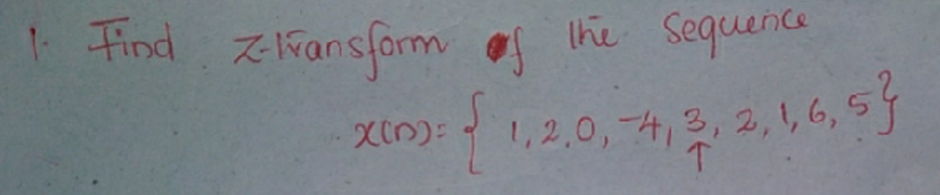
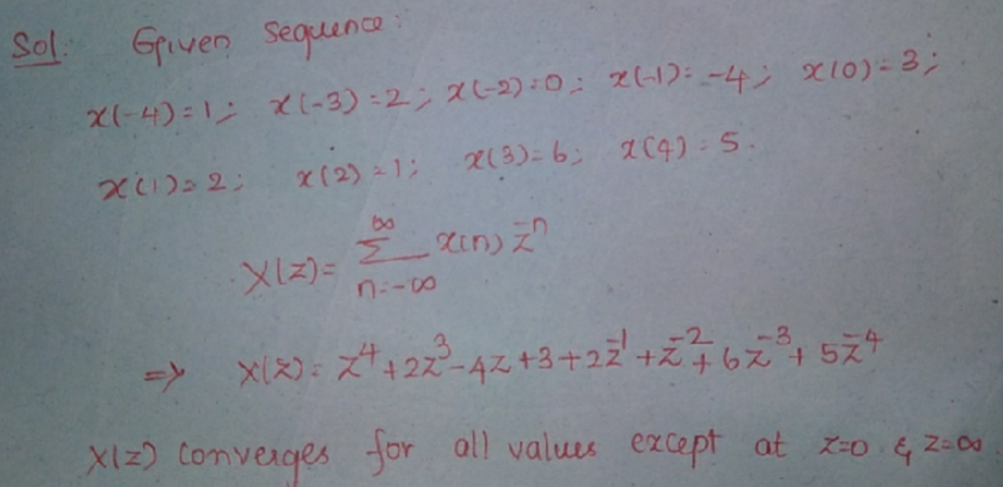

Slide 6
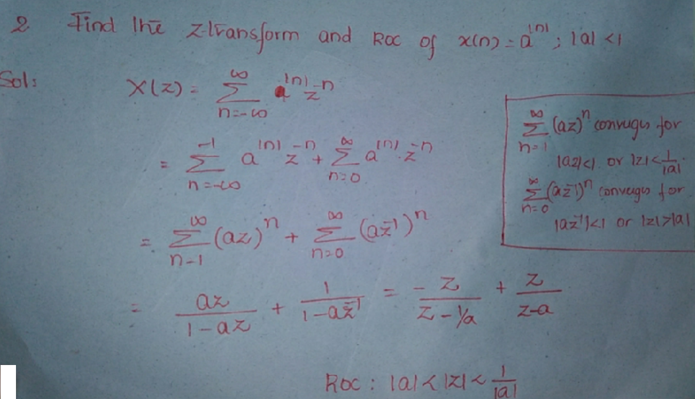

Slide 7
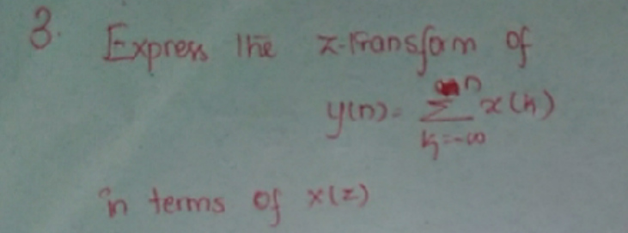
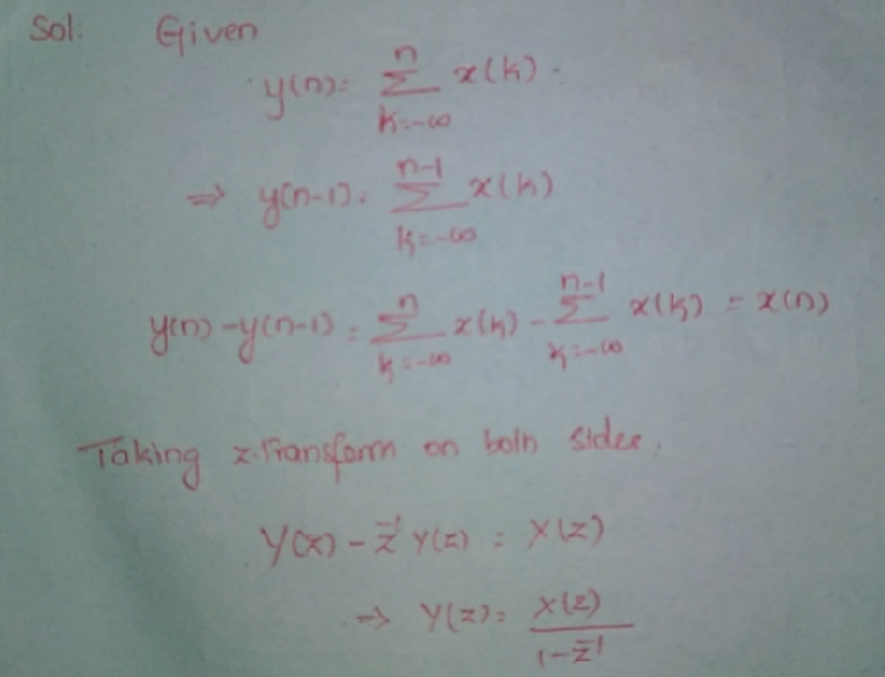

Slide 8
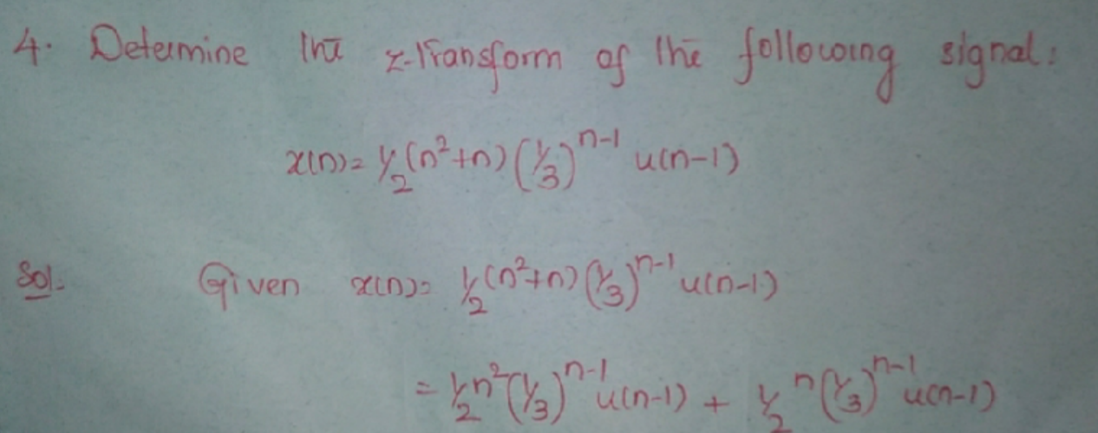
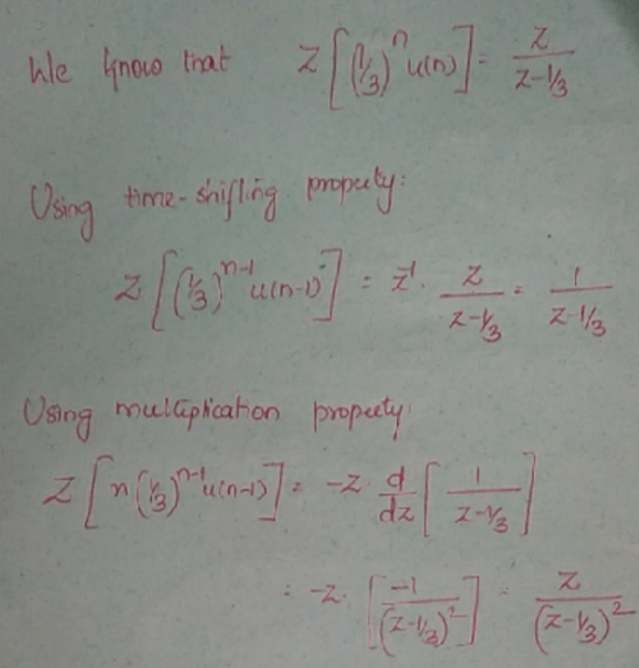
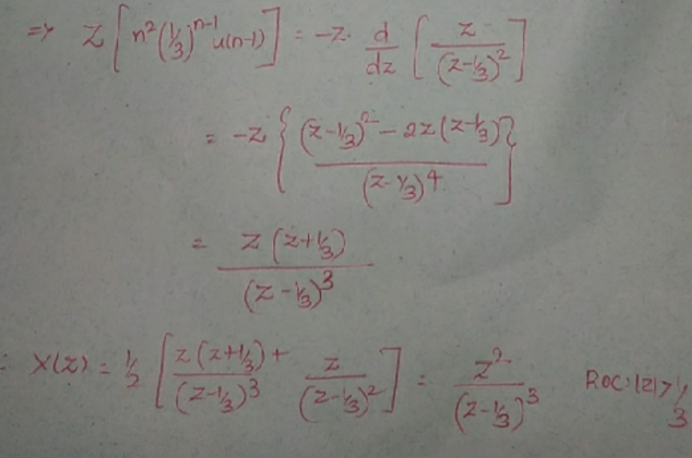

Slide 9
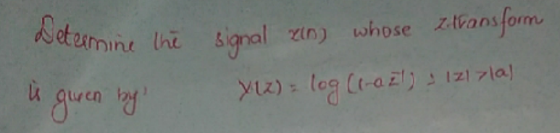
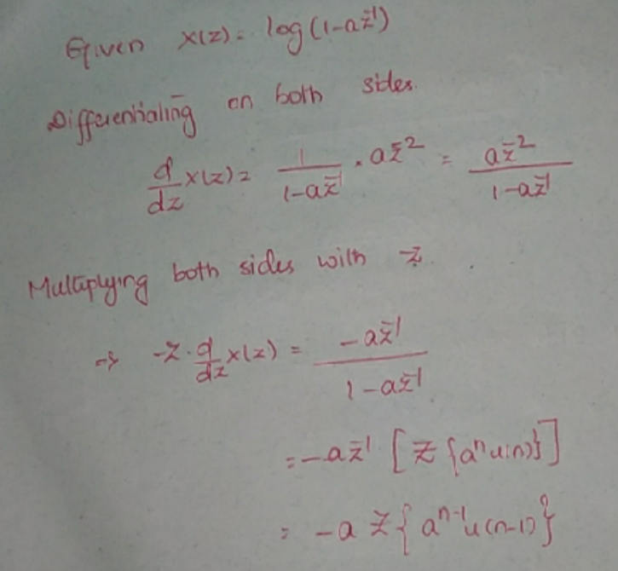
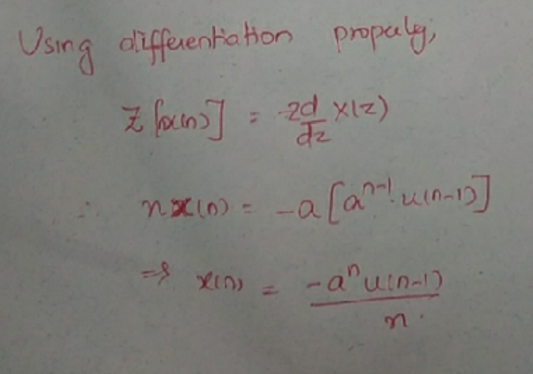

Slide 10
